Slide 1

LiDAR-based Canopy Cover prediction
May 10th Update
Alejandro Donaire Èric Sánchez Pau Ventura

Slide 2
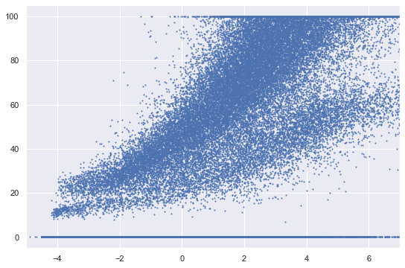
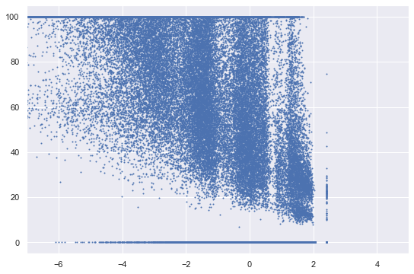
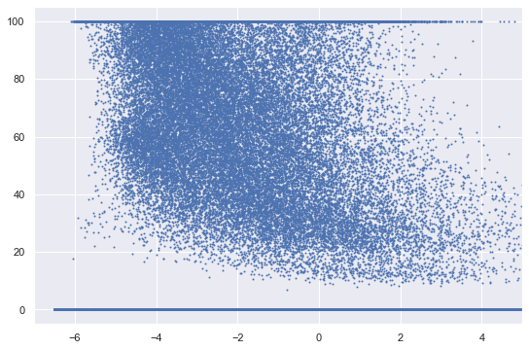
Tendencies study
Only intensity-related attributes
Only height-related attributes
Only return-related attributes

Slide 3
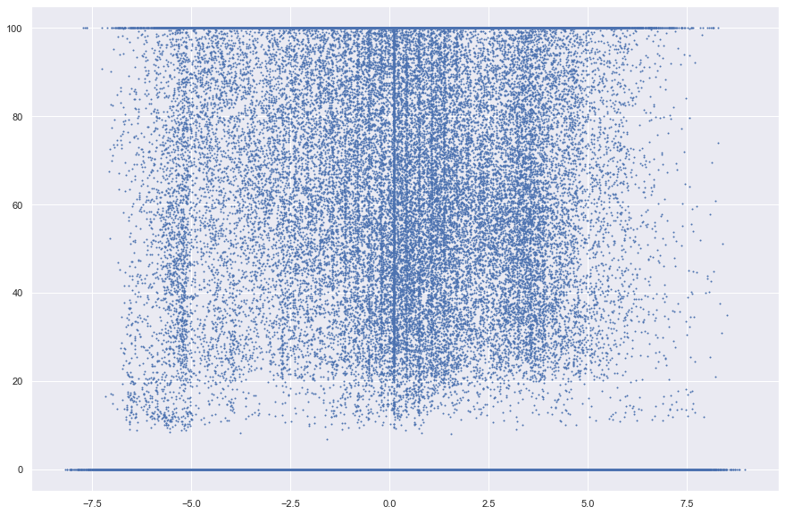
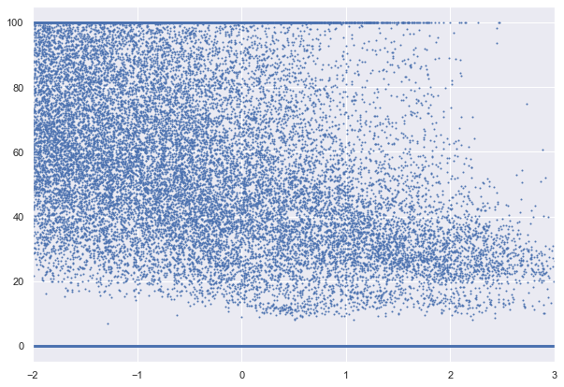
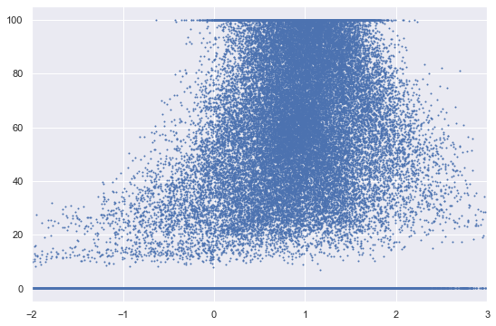
Tendencies study
Only classes-related attributes
Only angle-related attributes
Only return-related, angle-related and classes-related attributes (~80% CC)

Slide 4

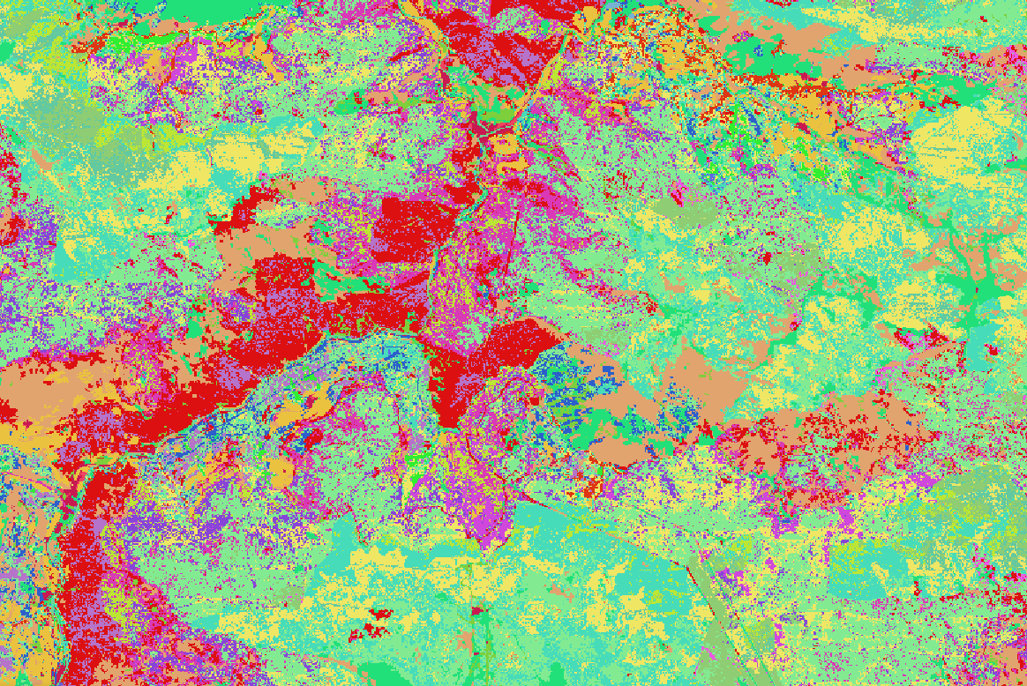

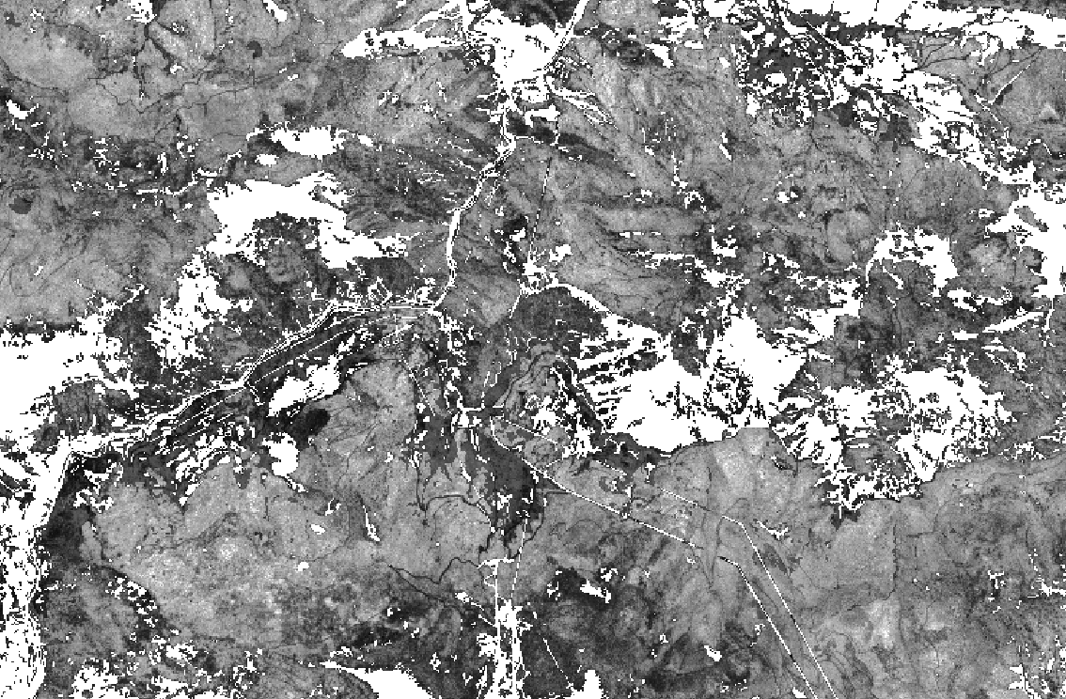
Paradigm Shift?
Adding fuel types (Burgan vs Anderson vs CC)

Slide 5
Paradigm Shift?
Better zero classification
No Fuels:
2325 77
134 464

Slide 6
Paradigm Shift?
Better zero classification
No Fuels: Fuels:
2325 77 2356 21
134 464 65 528
x3.6
x2

Slide 7
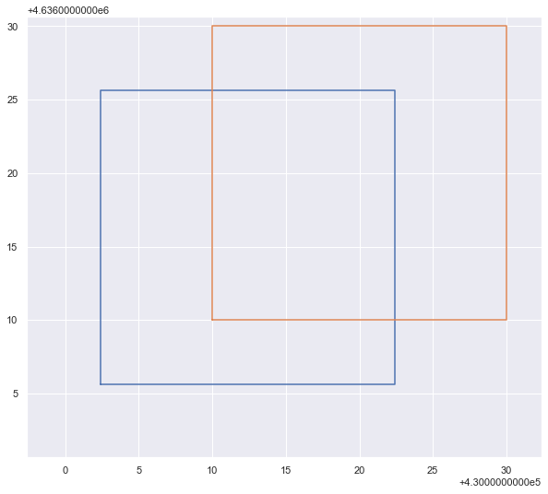
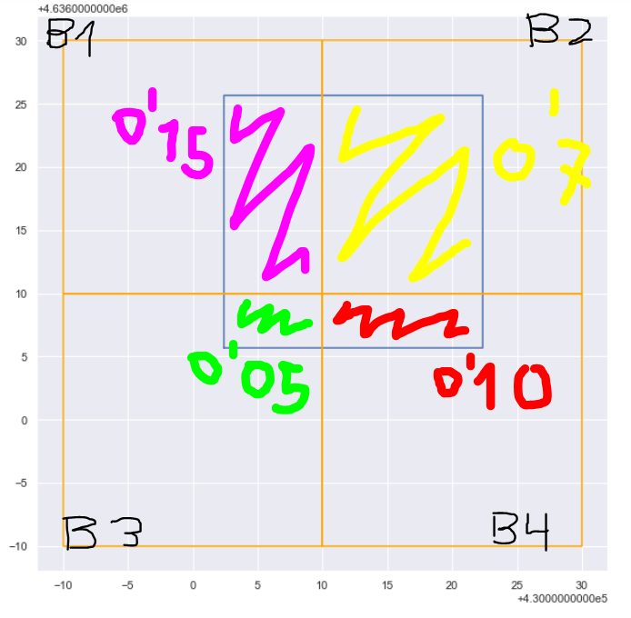
Fuels coordinates problem

Slide 8
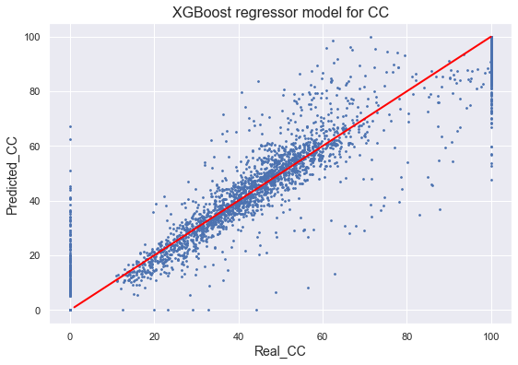

Paradigm Shift?
Model trained with fuel types
R² score: 0.888 (0.802) + 0.086
MAE score: 5.702 (8.532) - 2.830

Slide 9
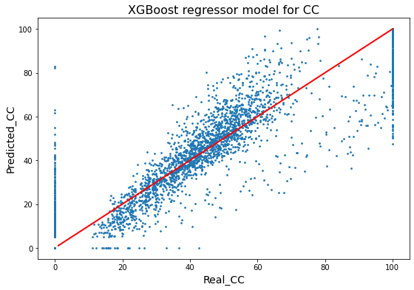
Paradigm Shift?
Comparing with the previous model (Predictions vs CC)
Previous model (fullblock)
Fuel type model (fullblock)

Slide 10
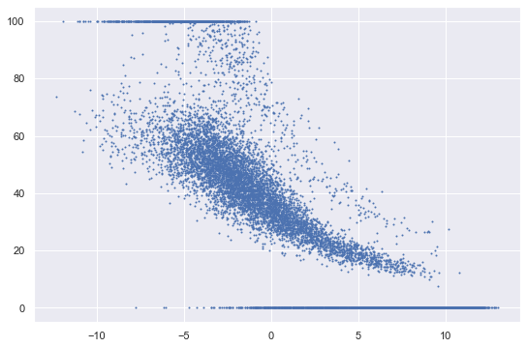
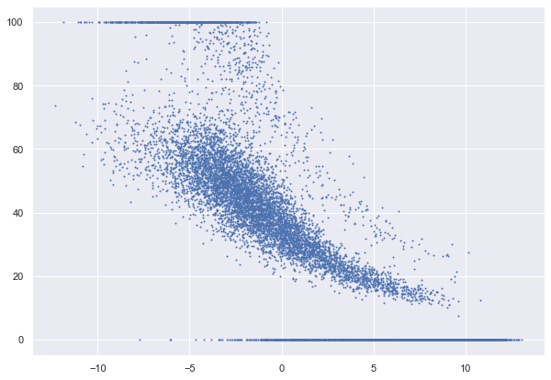
Paradigm Shift?
Comparing with the previous model (PCA vs CC) we still see the tendencies
Previous model (fullblock)
Fuel type model (fullblock)

Slide 11

Downloading ALL LiDAR data
In progress.
Contacted ICGC: Armand Güell i Mirabet (armand.guell@icgc.cat).
Data transferred using “bústia FTP”.

Slide 12
Problems / Research for next week
Start working with the cluster
Hyperparameter search at cluster (if we have the LiDAR data)
Continue with the full LiDAR data download.
Feature Selection with PCA
Further fuel analysis (more data)

